Slide 1


CLOUD COMPUTING
THINK CLOUD. THINK MASTECH DIGITAL.

Slide 2


We offer human innovation through digital and mainstream technology staffing, and digital transformation services.

Slide 3
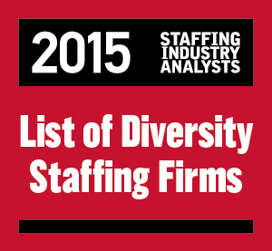
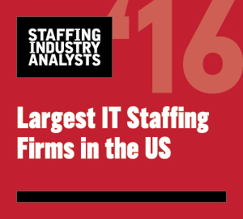




KEY HIGHLIGHTS
Pittsburgh-headquartered
Revenues @ $130 million
Minority-owned (Certified with NMSDC)
NYSE-listed (MHH)
Faster turnaround time
Hybrid Delivery Model (U.S. and India)
Technology-based recruiting delivery
We specialize in finding ”purple squirrels”
Successful engagement with leading clients across industries
Financial Services
Insurance
Healthcare
Manufacturing
Retail
Energy
Telecom
Aviation
Awards

Slide 4




OFFERINGS
Digital Staffing
Social | Mobility | Analytics | Cloud | Automation | IoT | UX/UI
Mainstream Technology Staffing
Mainframes | Databases | Middleware | Enterprise Systems | SoA and Web Services | Data Warehousing | Verification and Validation | IT Administration | IT Helpdesk and Support Business Analysis | Project Management| |
Digital Transformation Services
CRM on Cloud | Enterprises Analytics | Digital Learning Services

Slide 5

CLOUD COMPUTING
JOINING THE DOTS – BEYOND THE SERVER

Slide 6

I don’t need a hard disk in my computer if I can get to the server faster… carrying around these non-connected computers is byzantine by comparison. - Steve Jobs, late chairman of Apple (1997)

Slide 7

STAFFING FOCUS ACROSS THE CLOUD JOURNEY
Technical Skills for Cloud Implementation
Business IT Alignment
Project / Program Management
IT Service Management
Risk Management

Slide 8

CLOUD SKILLS
LET’S FILL THE GAPS

Slide 9









CLOUD SKILLS
Enterprise Architecture
Service Oriented Architecture | IT Service Management | ITIL
Public Cloud Service
Cloud APIs

Slide 10
CLOUD SKILLS
Open Source
OpenStack | Cloud Foundry | KVM | Docker | Apache Mesas | Mango DB | OpenShift | Jenkings | Ceph CloudStack | Core OS | Couch DB
Project Management Skills
Migration to Cloud | Integration with existing systems | Identifying interdependencies
Security / Risk Management
Security Analysts | Network Security (including SDN/NFV) | Cloud Security Specialist | Data Security Specialist

Slide 11




CLOUD SKILLS
CPM / Orchestration Frameworks
OpenStack | CloudStack | vCAC
Linux / Unix
LINUX skills for common tasks (DHCP, DNS, firewall, web server, proxy, etc.)
Cloud Strategists
Business-savvy IT people | Understand IT impact on finance and business | Software development (DevOps) | Identity Management | Directory Services | Understand the impact on Mobility / BYOD

Slide 12


CLOUD SKILLS
Systems Automation
Scripting Languages | Configuration Management: Puppet, Chef, Salt Ansble, CFEngine | PERL, Python, Ruby
Ancillary Skills
/ Data Analytics | Containers |
Micro-services
Project Management
Project delivery capabilities in Cloud-based initiatives | Co-owned project management | SLA-based project delivery

Slide 13

Boston
Pittsburgh
Fremont
Chicago
Denver
Dallas
Orlando
Tampa
NOIDA

Slide 14


Thank You
For queries please contact:
+1.800.627.8323
experience@mastechdigital.com

